Slide 1
Aggregation
C393: Database Systems

Slide 2
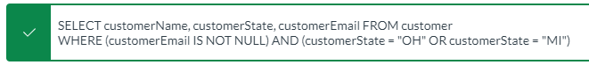

Review 5

Slide 3

Review 5

Slide 4
Review

Slide 5
Lesson Objectives
Apply the GROUP BY clause to aggregate data
Differentiate between HAVING and WHERE

Slide 6
Aggregation
SELECT SUM(balance)
FROM CadetAccount
GROUP BY owner;
SELECT owner, SUM(balance)
FROM CadetAccount
GROUP BY owner;
- Any values in the SELECT clause must be an aggregate, or present in the GROUP BY clause
SELECT accountId, owner, SUM(balance)
FROM CadetAccount
GROUP BY owner;

Slide 7
Aggregation Functions
COUNT
MIN
MAX
SUM
AVG
COUNT(DISTINCT)
STDDEV
MySQL :: MySQL 8.0 Reference Manual :: 14.19.1 Aggregate Function Descriptions

Slide 8
Aggregation
- Grouping by multiple columns is possible
SELECT cNum, company, min(balance)
FROM CadetAccount AS a
INNER JOIN Cadet AS c
ON a.owner = c.cNum
GROUP BY cNum, company;

Slide 9
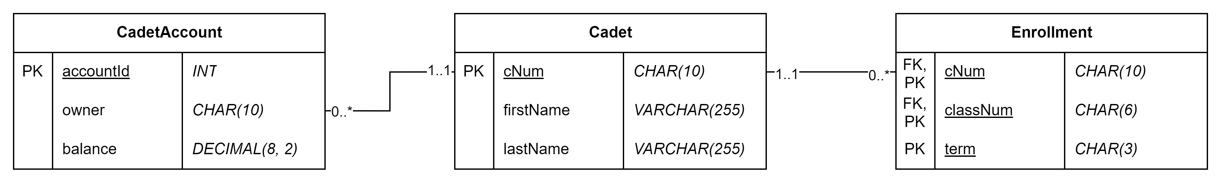
Try it out
Download/import the cadet database
Find the lowest account balance by company
Get the total balance by Cadet
Count how many students are in CS393
Count enrollments by class, and term

Slide 10
Aggregate Criteria

Slide 11
HAVING vs WHERE
SELECT FROM WHERE GROUP BY HAVING ORDER BY;
The WHERE clause filters out records before the grouping takes place.
Must not be on an aggregate
The HAVING clause filters out records after the grouping takes place.
Must be on an aggregate

Slide 12

HAVING
SELECT COUNT(*)
FROM Cadet
GROUP BY company
HAVING COUNT(*) = 0
List companies without any Cadets
List companies without any Cadets born on or after 2001
SELECT COUNT(*)
FROM Cadet
WHERE birthdate >= ‘2001-01-01’
GROUP BY company
HAVING COUNT(*) = 0

Slide 13
Try it out
Download/import the cadet database
Count the number of accounts per Cadet that are under 500
Which Cadets have a total net worth less than 500?
How many Cadets do not have accounts?
How many Cadets are not enrolled in a course in 25-1?

